Slide 1
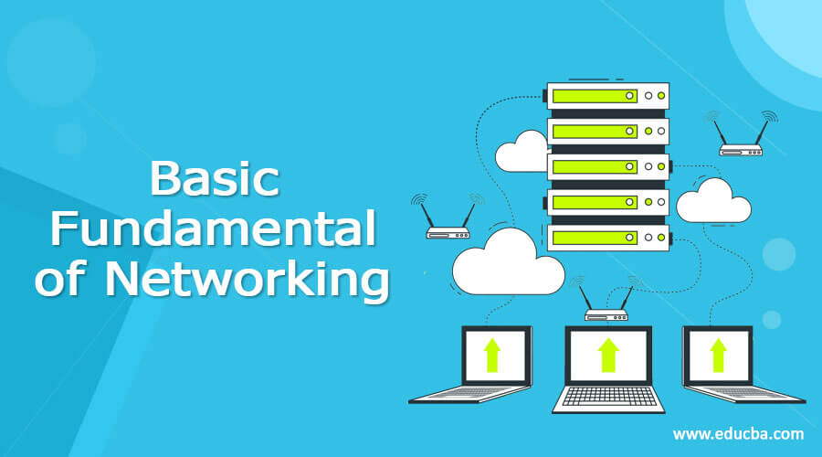
BASICS OF NETWORKING

Slide 2
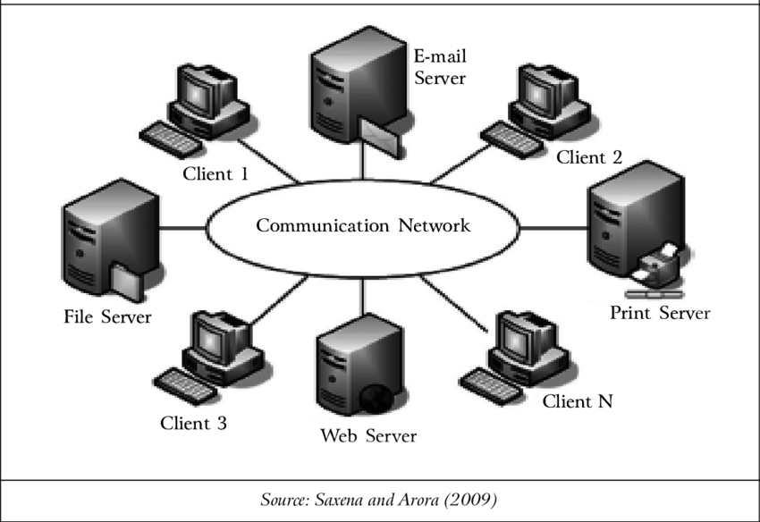
What is networking ????
networking, is the practice of transporting and exchanging data between nodes over a shared medium in an information system.
Or
A computer network is a set of computers sharing resources located on or provided by network nodes. The computers use common communication protocols over digital interconnections to communicate with each other

Slide 3
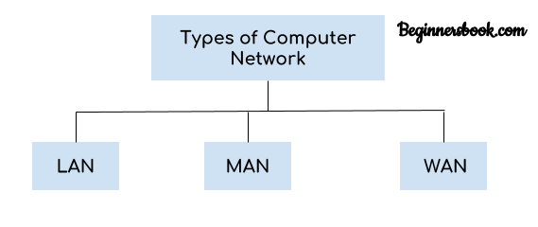
Types of Networking
Types of Networking
Networks differ based on size, connectivity, coverage and design. This guide explores seven common types of networks, including their benefits and use cases.
Local area network. ...
Metropolitan area network. ...
Wide area network. ..

Slide 4
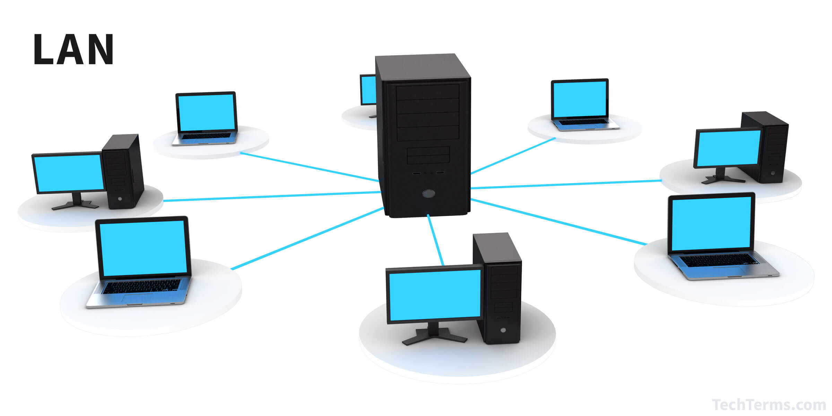
LOCAL AREA NETWORK
Advantage | Disadvantage
The fundamental LAN setup is not outrageously costly. | Because it is just so easy to gain access to other people's software components, security is a major problem. To restrict unwanted access, additional security tests are recommended.
A local area network is a computer network that interconnects computers within a limited area such as a residence, school, laboratory, university campus or office building

Slide 5
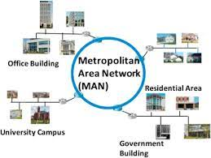
metropolitan area network (MAN)
A metropolitan area network (MAN) is a computer network that is larger than a single building local area network (LAN) but is located in a single geographic area that is smaller than a wide area network (WAN).

Slide 6
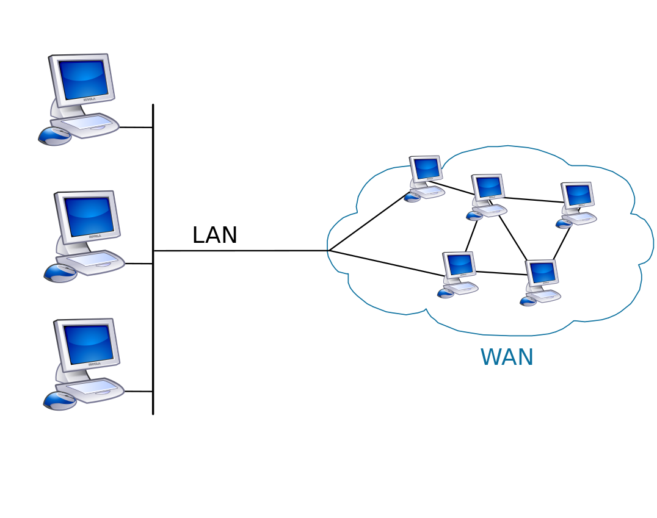
WIDE AREA NETWORK
A wide area network is a telecommunications network that extends over a large geographic area. Wide area networks are often established with leased telecommunication circuits
https://www.tutorialspoint.com/difference-between-lan-man-and-wan#:~:text=LAN%20stands%20for%20Local%20Area,stands%20for%20Wide%20Area%20Network.&text=LAN%20is%20often%20owned%20by%20private%20organizations.

Slide 7
Network fundamentals
Wired and wire less network
Linkes ,nodes
IP ADDRESS and subnet mask and MAC Add
LAYERS OF NETWORK
Diff types of networking devices-Routers,switches and Hubs
PROTOCOLS and ports.
Types of communication
DNS/DHCP/NIC
Data encryption and decryption

Slide 8
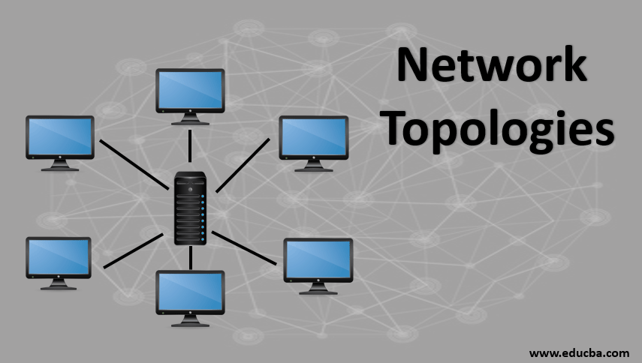

Slide 9
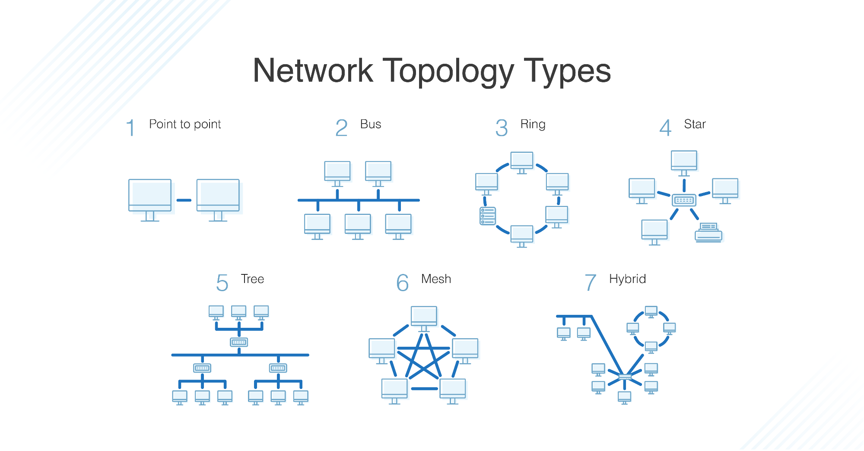

Slide 10
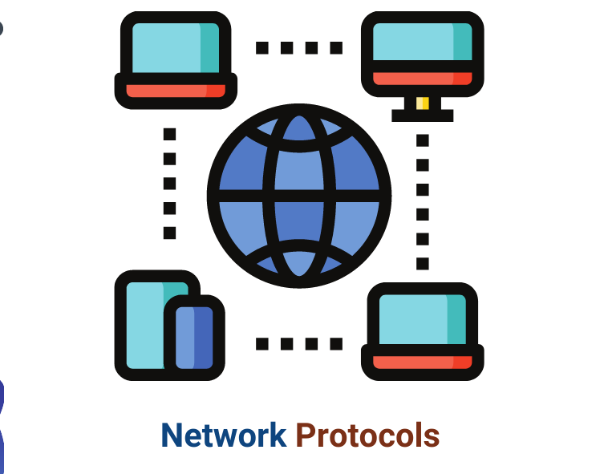
What are protocols
A network protocol is an established set of rules that determine how data is transmitted between different devices in the same network
The OSI (Open Systems Interconnection) Reference Model defines seven layers of networking protocols. ... In this model, there are four layers, including:
Ethernet (Physical/Data Link Layers)
IP/IPX (Network Layer)
TCP/SPX (Transport Layer)
HTTP, FTP, Telnet, SMTP, and DNS(combined Session/Presentation/Application Layers)
STUDY ALL PROTOCOLS

Slide 11
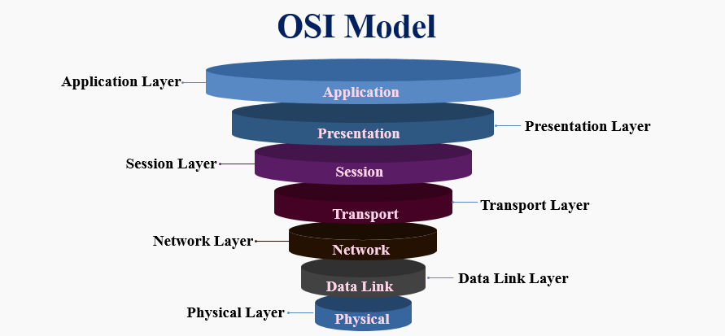
Layers in network
Separate notes shared for osi and TCP-IP Models
Kindly check them

Slide 12
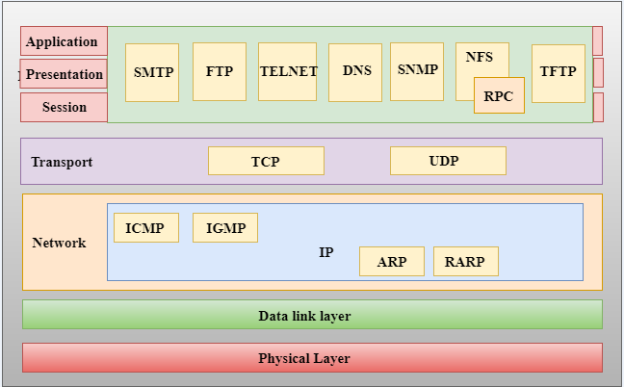
TCP-IP MODEL

Slide 13
IP ADDRESS
IP V4-32 BITS
IP V6-128 BITS
Computer understand data in form of BIT WHICH IS 0/1
8BIT =1 BYTE
8 BYTE = 1KB
1024 KB = 1 MB
1024 MB = 1GB
1024 GB= 1TB

Slide 14
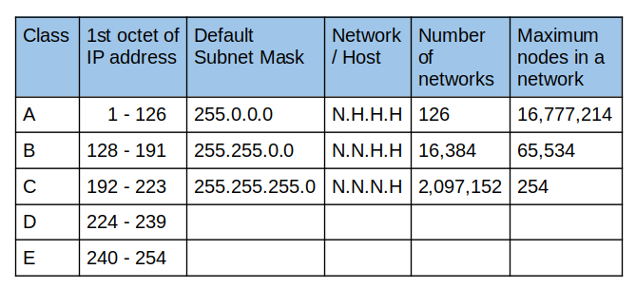
IPV4 ADDRESS
It’s a 32 bit address with 4 octats
127.0.01
The loopback address, also called localhost, is probably familiar to you. It is an internal address that routes back to the local system. The loopback address in IPv4 is 127.0. 01
A 0.0. 0.0 address indicates the client isn't connected to a TCP/IP network, and a device may give itself a 0.0. 0.0 address when it is offline.

Slide 15
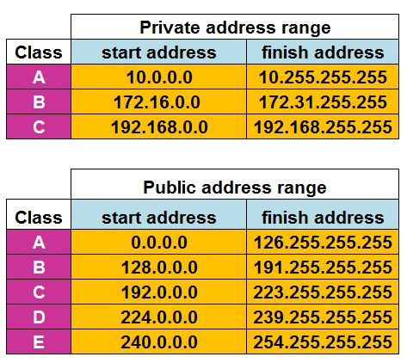
Private and public ip address
A private IP address is a range of non-internet facing IP addresses used in an internal network. Private IP addresses are provided by network devices, such as routers, using network address translation.
A public IP address is an IP address that can be accessed directly over the internet and is assigned to your network router by your internet service provider (ISP)
https://www.avast.com/c-ip-address-public-vs-private#:~:text=A%20public%20IP%20address%20identifies,a%20unique%20private%20IP%20address.

Slide 16
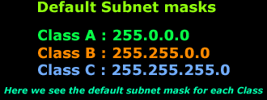
Sub netting
A subnetwork or subnet is a logical subdivision of an IP address into network and host bits

Slide 17
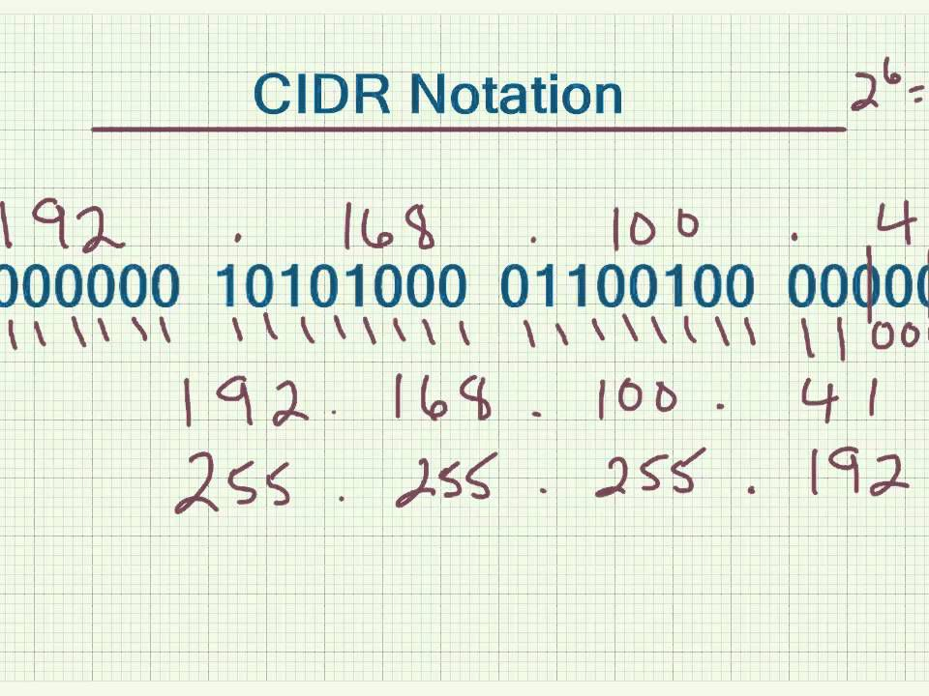
CIDR
Classless Inter-Domain Routing (CIDR) is a range of IP addresses a network uses. A CIDR address looks like a normal IP address, except that it ends with a slash followed by a number. The number after the slash represents the number of addresses in the range.

Slide 18
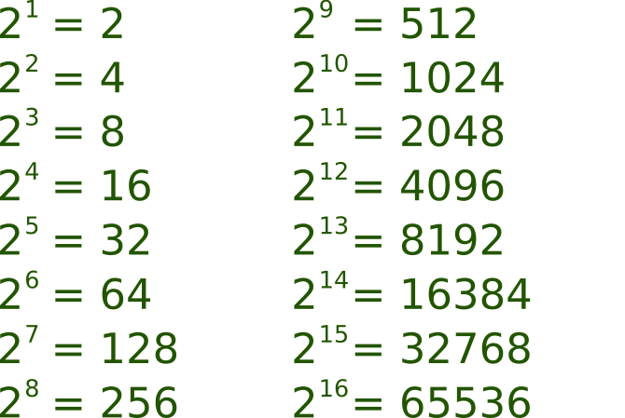

Slide 19
OPERATING SYSTEM
https://www.geeksforgeeks.org/difference-between-linux-and-windows/
An operating system is system software that manages computer hardware, software resources, and provides common services for computer programs
An operating system (OS) is the program that, after being initially loaded into the computer by a boot program, manages all of the other application programs in a computer. The application programs make use of the operating system by making requests for services through a defined application program interface (API).
Linux, Windows, macOS. 64-bit OS and 32-bit OS. Batch OS, Time-Sharing OS, Distributed OS, Real-Time OS, Networking OS

Slide 20
RDP AND SSH
Remote desktop protocol (RDP) is a secure network communications protocol developed by Microsoft. It enables network administrators to remotely diagnose problems that individual users encounter and gives users remote access to their physical work desktop computers.
SSH or Secure Shell is a network communication protocol that enables two computers to communicate (c.f http or hypertext transfer protocol, which is the protocol used to transfer hypertext such as web pages) and share data.

Slide 21
WHAT IS CLOUD COMPUTING
Cloud computing is the on-demand availability of computer system resources, especially data storage and computing power, without direct active management by the user.
cloud computing is the delivery of computing services—including servers, storage, databases, networking, software, analytics, and intelligence—over the Internet (“the cloud”) to offer faster innovation, flexible resources, and economies of scale.

Slide 22
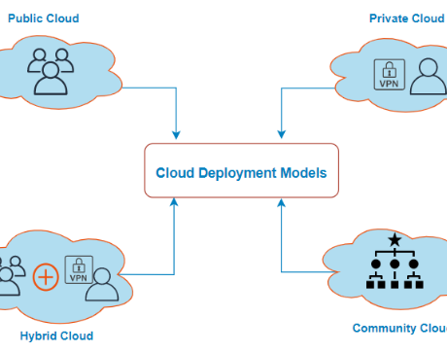
Cloud deployment model
There are 4 main types of cloud deployment model: private clouds, public clouds, hybrid clouds, and multiclouds
Public cloud is a cloud deployment model where computing resources are owned and operated by a provider and shared across multiple tenants via the Internet.
The private cloud is defined as computing services offered either over the Internet or a private internal network and only to select users instead of the general public.
hybrid cloud platforms connect public and private resources in different ways, but they often incorporate common industry technologies, such as Kubernetes to orchestrate container-based services. Examples include AWS Outposts, Azure Stack, Azure Arc, Google Anthos and VMware Cloud on AWS.
A community cloud in computing is a collaborative effort in which infrastructure is shared between several organizations from a specific community with common concerns,

Slide 23
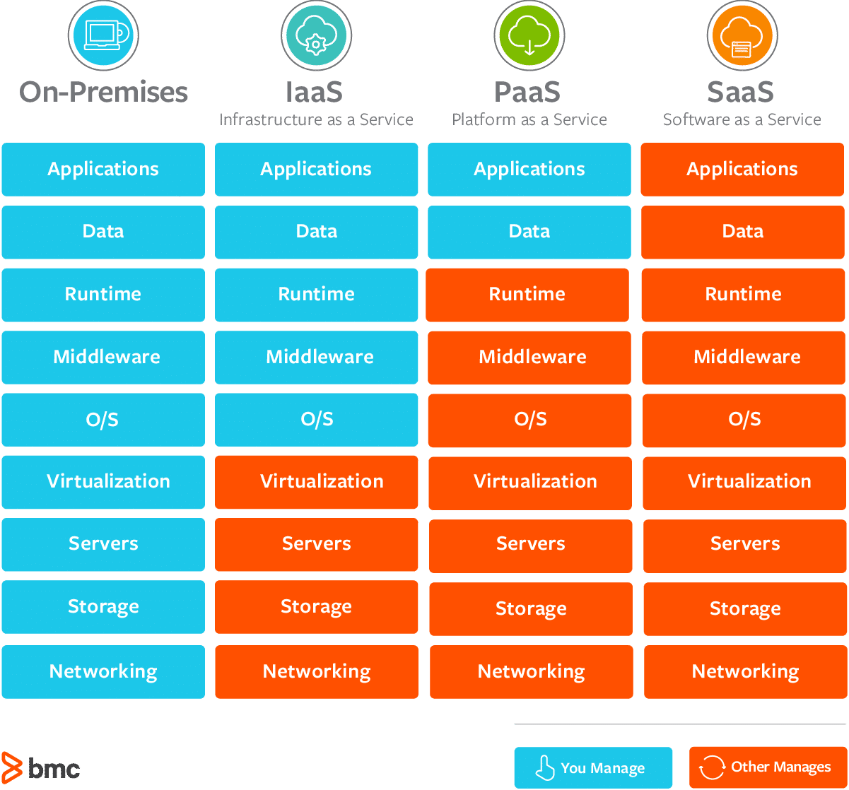
Cloud service models
There are three major cloud service models: software as a service (SaaS), infrastructure as a service (IaaS) and platform as a service (PaaS).
https://www.techtarget.com/whatis/SaaS-IaaS-PaaS-Comparing-Cloud-Service-Models

Slide 24
Infrastructure as a Service (IaaS)
Infrastructure as a Service (IaaS)
IaaS is also known as Hardware as a Service (HaaS). It is a computing infrastructure managed over the internet. The main advantage of using IaaS is that it helps users to avoid the cost and complexity of purchasing and managing the physical servers.
Characteristics of IaaS
There are the following characteristics of IaaS -
Resources are available as a service
Services are highly scalable
Dynamic and flexible
GUI and API-based access
Automated administrative tasks
Example: DigitalOcean, Linode, Amazon Web Services (AWS), Microsoft Azure, Google Compute Engine (GCE), Rackspace, and Cisco Metacloud.

Slide 25
Platform as a Service (PaaS)
Platform as a Service (PaaS)
PaaS cloud computing platform is created for the programmer to develop, test, run, and manage the applications.
Characteristics of PaaS
There are the following characteristics of PaaS -
Accessible to various users via the same development application.
Integrates with web services and databases.
Builds on virtualization technology, so resources can easily be scaled up or down as per the organization's need.
Support multiple languages and frameworks.
Provides an ability to "Auto-scale".
Example: AWS Elastic Beanstalk, Windows Azure, Heroku, Force.com, Google App Engine, Apache Stratos, Magento Commerce Cloud, and OpenShift.

Slide 26
Software as a Service (SaaS
SaaS is also known as "on-demand software". It is a software in which the applications are hosted by a cloud service provider. Users can access these applications with the help of internet connection and web browser.
Characteristics of SaaS
There are the following characteristics of SaaS -
Managed from a central location
Hosted on a remote server
Accessible over the internet
Users are not responsible for hardware and software updates. Updates are applied automatically.
The services are purchased on the pay-as-per-use basis
Example: BigCommerce, Google Apps, Salesforce, Dropbox, ZenDesk, Cisco WebEx, ZenDesk, Slack, and GoToMeeting.

